Slide 1
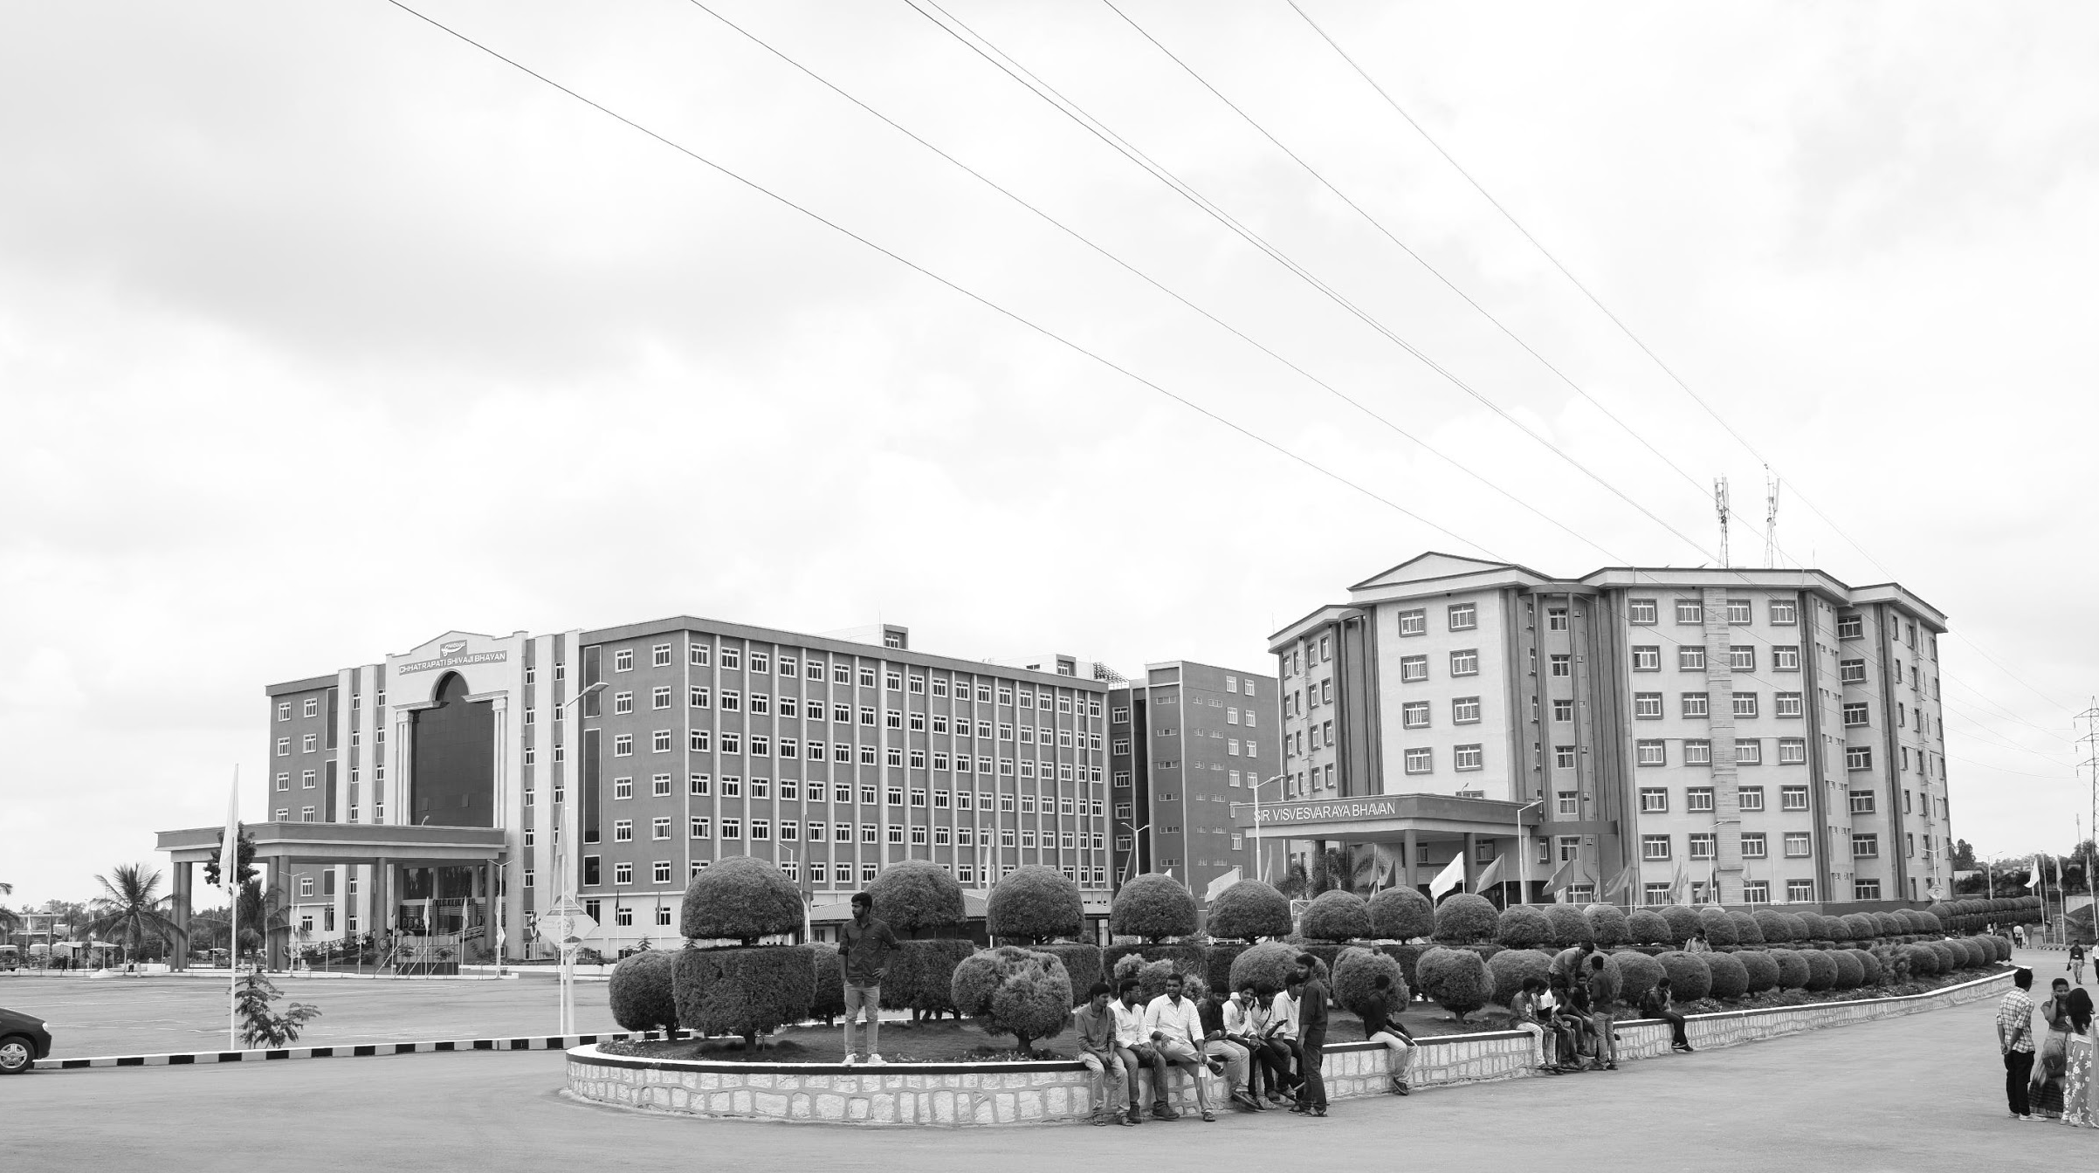

Review-I
Cloud Monitoring Heart Beat Sensor Data for Worker and Soldier in Hostile Conditions
AY 2025-26
Capstone Project
GITAM (Deemed-to-be) University
Department of Electrical Electronics and Communication Engineering
Project Team:
BU22EECE0100088 - S Sheshu
BU22EECE0100444 - Prajwal Kumar
BU22EECE0100447 - Shravani A
Project Mentor:
Kshitij Shakya
Project In-charge:
Subhashish Tiwari
www.gitam.edu

Slide 2
Objective and Goals
Objective
The objective of this project is to design and implement a reliable cloud-based heart rate monitoring system that continuously measures and analyzes the heartbeat of workers and soldiers operating in hostile or remote environments. By integrating pulse sensors with IoT platforms, the system aims to:
Ensure real-time monitoring of vital signs.
Enable remote access to health data through cloud storage.
Provide early alerts in case of abnormal heart activity.
Enhance safety, decision-making, and rapid medical response in high-risk conditions where traditional healthcare access is limited.
Goals
Main Goals
Continuous monitoring of heart rate using pulse sensors.
Real-time transmission of heartbeat data to the cloud for remote access.
Visualization of health status through OLED display and cloud dashboards.
Early detection of abnormal heartbeat patterns with instant alerts.
Reliable operation in hostile and remote environments.
Additional Goals
Ensure portability and low power consumption for field deployment.
Provide secure data logging for long-term health analysis.
Enable scalability to support multiple users (workers/soldiers) simultaneously.

Slide 3
Problem Statement / Research Gap
Most existing heartbeat monitoring systems are limited to local displays (OLED/LCD) and do not provide remote/cloud access.
Lack of continuous monitoring in hostile or remote environments (battlefields, disaster zones, mines).
Soldiers and workers in extreme conditions are exposed to high risk without real-time health tracking.
Existing research often focuses on laboratory or hospital setups, not on field-deployable, IoT-enabled systems.
No integrated system that combines pulse sensing + cloud storage + real-time visualization for proactive health response.

Slide 4
Literature Survey
Title and Author | Problem statement | Methodology | Result
Real-Time Health Monitoring and Tracking System of Soldiers Using IoT Aradhana Sahu, Pranali Ghotekar, Shrinivas Patil, Rutuja Ghodke | Soldiers in remote/hostile areas face health risks without immediate medical aid, and there is no system for continuous real-time monitoring of their health and location. | Wearable sensors for heart rate, ECG, and temperature • Arduino + GPS + GSM (SIM808) to collect & transmit data • Soldier node → Squadron node → Control center node • Panic button + alert system for emergencies | System enables real-time monitoring of soldier’s health & location, generates emergency alerts, and improves safety and battlefield decision-making.
Online Monitoring Health Station Using Arduino Mobile Connected to Cloud service: “Heart Monitor” System Eman Abed-Alkareem Karajah, Isam Ishaq (Al-Quds University, Jerusalem, Palestine) | Many patients need continuous monitoring of vital signs (heart rate, body temperature). Existing solutions are costly, require hospital visits, and lack real-time remote monitoring. | Developed an Arduino Uno-based circuit with heart rate sensor (SN-11574), LM35 temperature sensor, HC-05 Bluetooth module. Data is sent to an Android app, displayed, stored in Google Sheets cloud, with alarms and automatic calling after 5 abnormal readings. | The proposed “Heart Monitor” system achieved 97.4% accuracy compared to an ECG device. It provides real-time monitoring, alarm alerts, and automatic calls during abnormal readings.

Slide 5
Title and Authur | Problem Statement | Methodology | Result
Health Monitoring System Prof. R. R. JainNidhi GuptaAnusha VartakRevati Tamboli | Bedridden and critical care patients require constant monitoring of vital parameters. Since doctors or relatives cannot be present all the time, delays in detecting issues like sudden temperature changes, falls, or diet irregularities can be life-threatening. Thus, a system for remote and continuous health monitoring is essential. | The system uses temperature, accelerometer, and vibration sensors to monitor patients. An embedded system processes the data and sends it via Bluetooth to a smartphone app, which tracks temperature, detects falls, monitors diet, and sends alerts. An admin PC stores patient data and diet schedules for doctor reference. | The system monitors body temperature, diet, and falls, sending alerts to doctors or relatives for timely response. While the prototype works, it needs further optimization for compactness and broader use.
IoT Based Health Monitoring System Prajoona Valsalan, Tariq Ahmed Barham Baomar, Ali Hussain Omar Baabood. | Healthcare faces challenges in timely diagnosis, especially during epidemics or in rural areas with limited facilities. Frequent hospital visits are costly, so a remote system is needed to monitor vital signs and share data with doctors for proper diagnosis. | An IoT-based health monitoring system was built with sensors to track vital signs, processed by a microcontroller and sent to the cloud. The data, stored on a medical server, is accessible to doctors for remote diagnosis using a rule-based system. | The prototype successfully monitored and transmitted sensor data to the IoT platform, enabling doctors to remotely diagnose patient conditions. This reduced hospital visits and supported timely intervention, proving effective for epidemics and rural healthcare.

Slide 6
Title and Author | Problem statement | Methodology | Result
Automated Remote Cloud-Based Heart Rate Variability Monitoring System Ahmed Faeq Hussein, Arun Kumar N, Marlon Burbano-Fernandez, Gustavo Ramírez-González, Enas Abdulhay, Victor Hugo C. De Albuquerque | Lack of effective heart health monitoring in remote areas; need for continuous, secure patient tracking | Wearable ECG sends data to the cloud, analyzed for heart rate variability using secure algorithms and web | High accuracy (>99%), enables easy remote monitoring and secure data access for doctors and patients
HealthCloud: A system for monitoring health status of heart patients using machine learning and cloud computing Forum Desai, Deepraj Chowdhury, Rupinder Kaur, Marloes Peeters, Rajesh Chand Arya, Gurpreet Singh Wander, Sukhpal Singh Gill, Rajkumar Buyya | Early heart disease detection and monitoring is challenging; existing self-diagnosis and home systems lack accuracy and reliability | Mobile application uses machine learning models (SVC, KNN, NN, LR, GBT) and cloud computing (Google Firebase) for heart disease prediction based on user data | Logistic Regression was most accurate (85.96%), efficient and responsive; system enables reliable health assessment and real-time monitoring for patients

Slide 7
Novelty (What’s New in our Work?)
Integration of low-cost sensors (Pulse + DHT11 + ADS1115) with NodeMCU ESP8266 for real-time cloud monitoring.
Unlike existing systems, data is not just shown locally but transmitted to the cloud for remote access.
Use of OLED display for immediate field feedback while also enabling cloud visualization.
System designed to be portable, lightweight, and adaptable for both soldiers and workers in extreme environments.

Slide 8
Social Importance (Why Does It Matter?)
Provides continuous health monitoring in hostile / remote conditions where medical support is not immediately available.
Helps prevent sudden health crises (cardiac arrest, dehydration, fatigue) by early detection.
Enables command centers / supervisors to track the health of soldiers or workers in real time, ensuring safety & timely intervention.
Can be extended to civilian use: disaster relief workers, miners, firefighters, and elderly care.
Promotes affordable and scalable healthcare monitoring, especially in resource-limited areas.

Slide 9
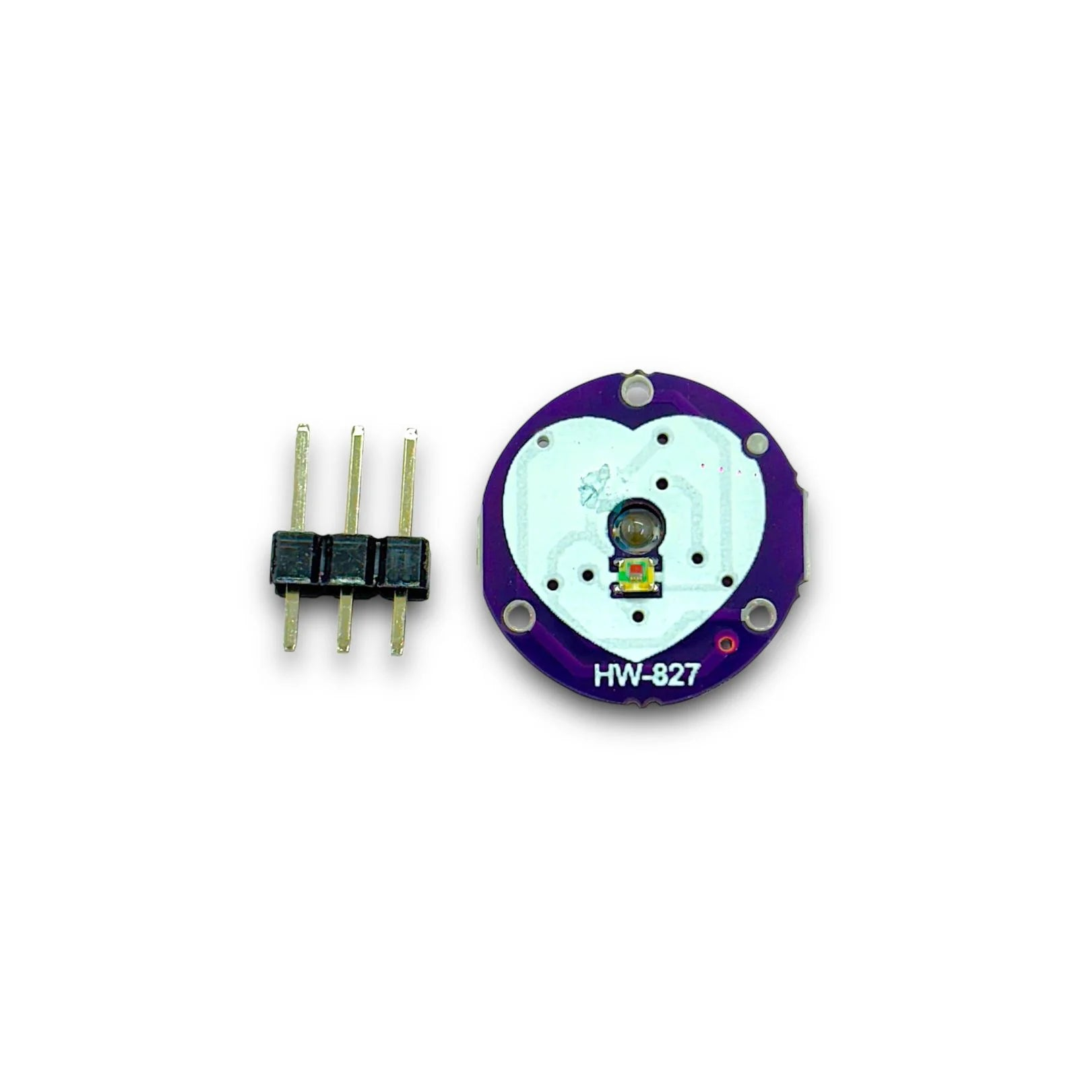
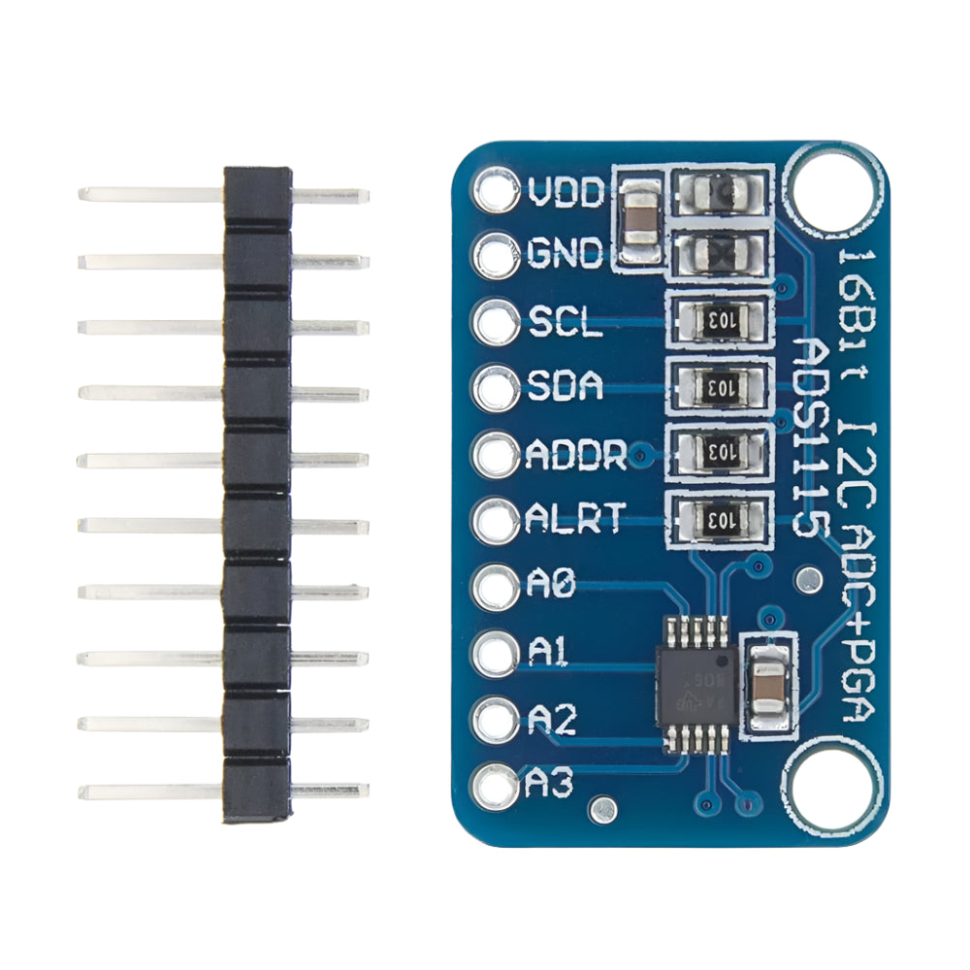
Component Required
Pulse Sensor (HW-827)
Captures heartbeat signals from the fingertip.
Outputs weak analog voltage proportional to heartbeat.
Requires filtering/resistor to reduce noise.
ADS1115 (16-bit ADC Module)
Converts the analog signal from the pulse sensor into digital data.
Provides accurate resolution (better than NodeMCU’s built-in ADC).
Multiple channels (A0–A3) → allows connecting
sensor + potentiometer.

Slide 10
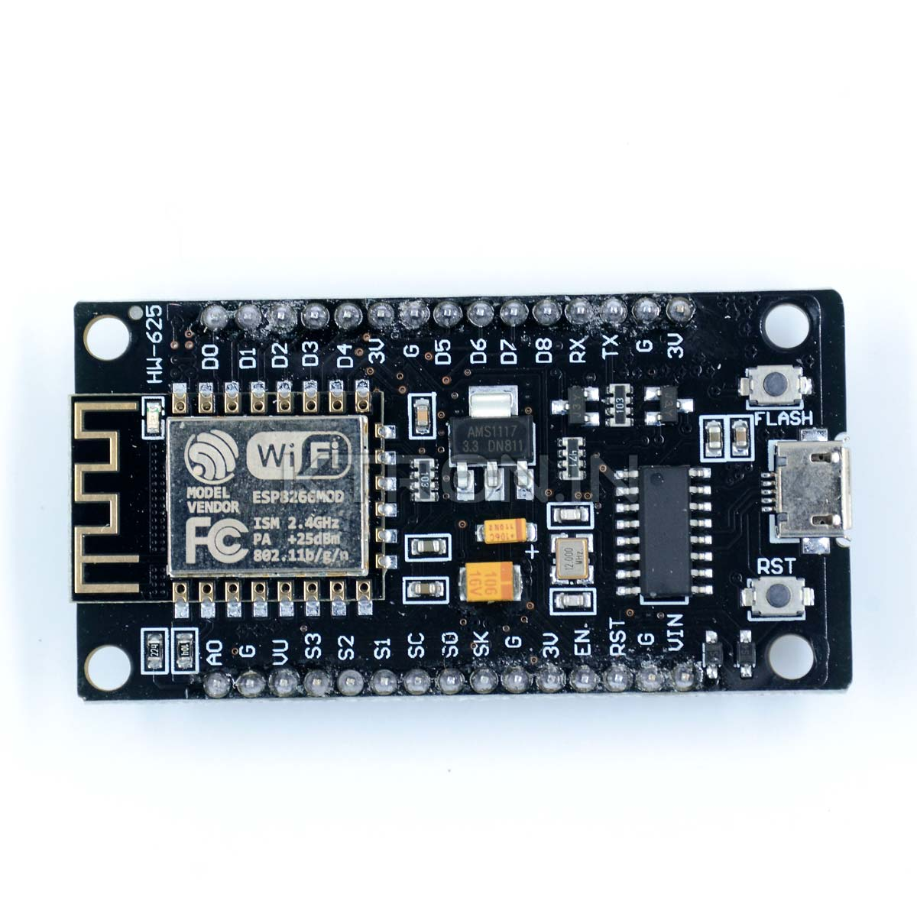
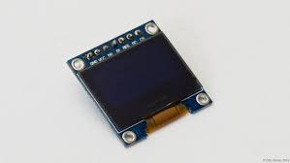
NodeMCU ESP8266
Main controller and Wi-Fi module.
Collects sensor data from ADS1115.
Sends heartbeat values to cloud server for remote monitoring.
Controls local OLED display.
OLED Display (SSD1306, I2C)
Shows real-time waveform of heartbeat locally.
Useful for immediate field feedback even without internet.
Cloud (Firebase etc.)
Stores continuous health data.
Provides remote visualization dashboards for doctors, supervisors, or command centers.
Enables alerts/notifications in abnormal conditions.

Slide 11
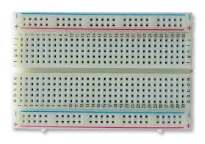
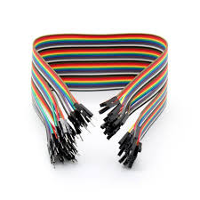
Breadboard
Solderless board for quick prototyping of circuits.
Has power rails and terminal strips for easy connections.
Allows adding/removing components without permanent wiring.
Reusable and ideal for testing multiple sensors together.
Jumper Wires
Used to make temporary connections on a breadboard.
Available as male-to-male, male-to-female, and
female-to-female.
Color-coded wires help separate power, ground, and signals.
Essential for linking sensors, modules, and microcontrollers.

Slide 12
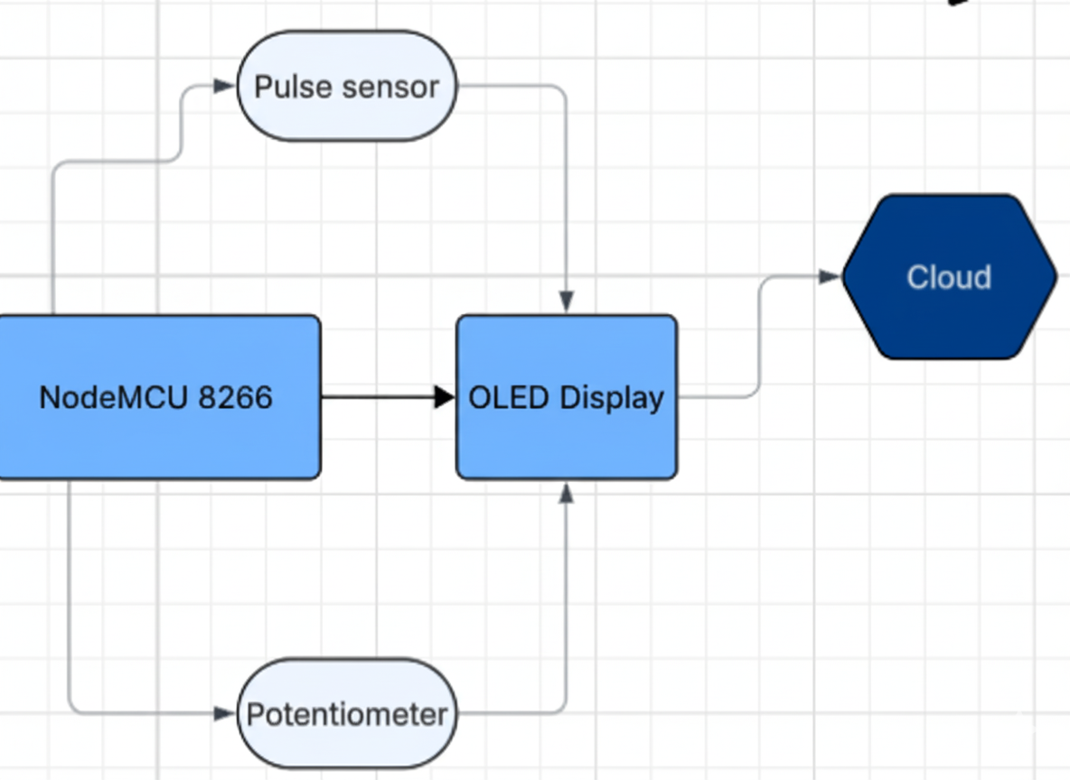
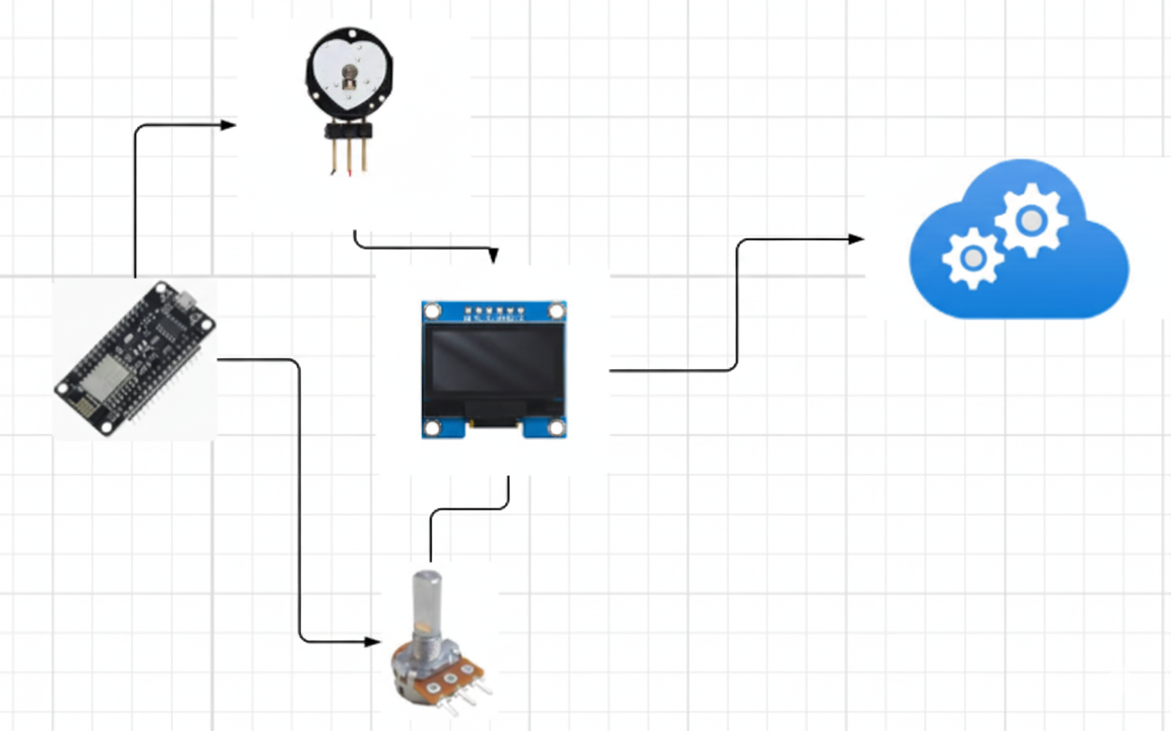
Block Diagram Architecture Diagram

Slide 13
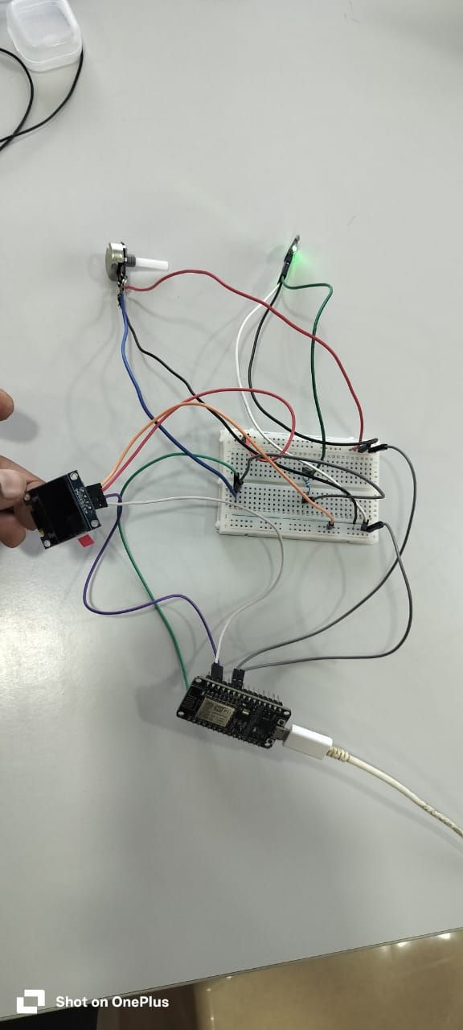
Results
#include <Wire.h>
#include <Adafruit_GFX.h>
#include <Adafruit_SSD1306.h>
#define SCREEN_WIDTH 128
#define SCREEN_HEIGHT 64
Adafruit_SSD1306 display(SCREEN_WIDTH, SCREEN_HEIGHT, &Wire, -1);
#define ANALOG_PIN A0 // NodeMCU Analog pin
#define MAX_POINTS 128 // OLED width = 128 pixels
int yValues[MAX_POINTS]; // store waveform points
int indexPos = 0;
void setup() {
Serial.begin(115200);
if (!display.begin(SSD1306_SWITCHCAPVCC, 0x3C)) {
Serial.println(F("SSD1306 allocation failed"));
for (;;);
}
display.clearDisplay();
display.display();
}
void loop() {
// Read sensor / potentiometer value
int sensorValue = analogRead(ANALOG_PIN);
// Map to OLED height
int y = map(sensorValue, 0, 1023, 0, SCREEN_HEIGHT - 1);
// Store point
yValues[indexPos] = y;
// Clear display for redraw
display.clearDisplay();
// Draw ECG-like waveform
for (int i = 1; i < MAX_POINTS; i++) {
int x1 = i - 1;
int y1 = yValues[(indexPos + i - 1) % MAX_POINTS];
int x2 = i;
int y2 = yValues[(indexPos + i) % MAX_POINTS];
display.drawLine(x1, y1, x2, y2, SSD1306_WHITE);
}
display.display();
// Increment index
indexPos = (indexPos + 1) % MAX_POINTS;
delay(30); // adjust for waveform speed
}

Slide 14
Conclusion & Future Work
Conclusion:
The proposed system successfully integrates Pulse Sensor + ADS1115 + NodeMCU + OLED + Cloud to provide real-time heartbeat monitoring.
It overcomes the limitation of existing systems by enabling remote cloud access rather than just local display.
Ensures safety and timely response for soldiers and workers in critical environments.
Future Work:
Extend the system to support multiple users simultaneously (monitoring a fullsquad/unit).
Improve cloud dashboard visualization (clearer waveforms, alerts, data history).
Add offline storage on NodeMCU8266 (SD card) for backup when internet/cloud is unavailable.
Enhance security & encryption for soldier/worker health data.
Miniaturize the hardware into a wearable device (armband).

Slide 15
THANK YOU
Have a Great Day !

